Slide 1
Our Children, Their Future, Our Vision
Notes:
Good Afternoon Ladies and Gentlemen and welcome to the 2013 AMM
I am Dr. Okocha and I am medical director and lead for Quality in Oxleas NHS FT
I will spend the next 10 minutes giving you an overview of Quality of care

Slide 2
Developing Attention for Communication

Slide 3
Introductions
Charlotte Wigg
Emaline Burgess
Specialist Speech and Language Therapists
ASD/Resourced Provision Teams

Slide 4
Aims for today’s session
What is ‘good attention’ and why is it important for communication?
What difficulties do we see in children who might need support with their attention?
How you can help your child in your day to day life to improve their attention; top tips!
Games to play with your child to help improve their attention
Notes:
Stephen to present

Slide 5
Attention and Listening Development
Just like a tree that needs good roots to be able to grow, successful communication needs a range of foundational skills which include (amongst others):
Listening
Shared attention
Turn taking

Slide 6
Attention skills for a primary aged child
What attention skills could we expect a key stage one child to have?
4-5 years old
Children of this age are expected to be able to switch their attention between activities with minimal adult support. They are expected to be able to carry out an activity whilst listening to an instruction at the same time. Attention span can still be quite short at this age.
5-6 years old
Children of this age are expected to have well established, fully integrated attention skills and to need minimal support from an adult.

Slide 7
How poor attention might affect a child’s communication development
If a child is not able to sustain and switch their attention they may have difficulty;
Following what the teacher is asking them to do in the classroom
Sitting still on a chair or on the carpet for a period of time
Being able to complete a task in the classroom or at home
Picking up on new vocabulary that is being used by others
Being able to participate in and follow conversations with peers
Expressing their ideas in a clear and sequenced manner
Being able to take turns with peers and play cooperatively
Notes:
Michelle to present

Slide 8
How you can help your child’s attention skills in day to day life
Before speaking to your child and/or giving them an instruction;
Ensure you are facing them and ideally get down to their level
Use their name at the start and wait for them to respond
Give instructions in ‘chunks’ so they don’t have to hold too much information at once
Give them extra time to process what you have said to them
Notes:
Michelle to Present

Slide 9
How you can help your child’s attention skills in day to day life
Observe them and praise for any signs of good listening before you notice a problem; “I can see you are listening to mummy because you are looking at me”
Reduce/remove likely distractions before you need to gain their attention eg, pause/switch off the screen
Model and promote ‘active listening’ – showing with our face and our body that we are listening to them

Slide 10
Conversation skills
In conversation, children with reduced attention skills may need support with turn-taking and topic maintenance. You can help by:
Playing turn-taking games as a family; have a talking object, if the person is holding the object it is their turn to talk. Praise everyone for waiting for their turn and not interrupting
Use a ‘good listening’ and/or ‘good waiting’ visual as a reminder
As a family, take some time to share news about your day; make sure everyone has a turn
Try using a ‘chat bag’; put some topic examples in a bag and everyone has a turn to pick one out; this is the topic you all talk about during your chat time

Slide 11
Visuals
Often children find it easier to attend when visuals are used alongside the spoken word
You could try:
A now and next (or first and then) board
A visual time table (eg for certain routines of the day)
A reward chart
A task management board
Timers; a sand-timer or use the one on your phone
Have a chat with your child’s school to see what they use so that you can do the same at home
Even if you think your child has listened to and understood the instruction, it can still help to use the visual support as a reminder
Notes:
Beverley Mack to present

Slide 12
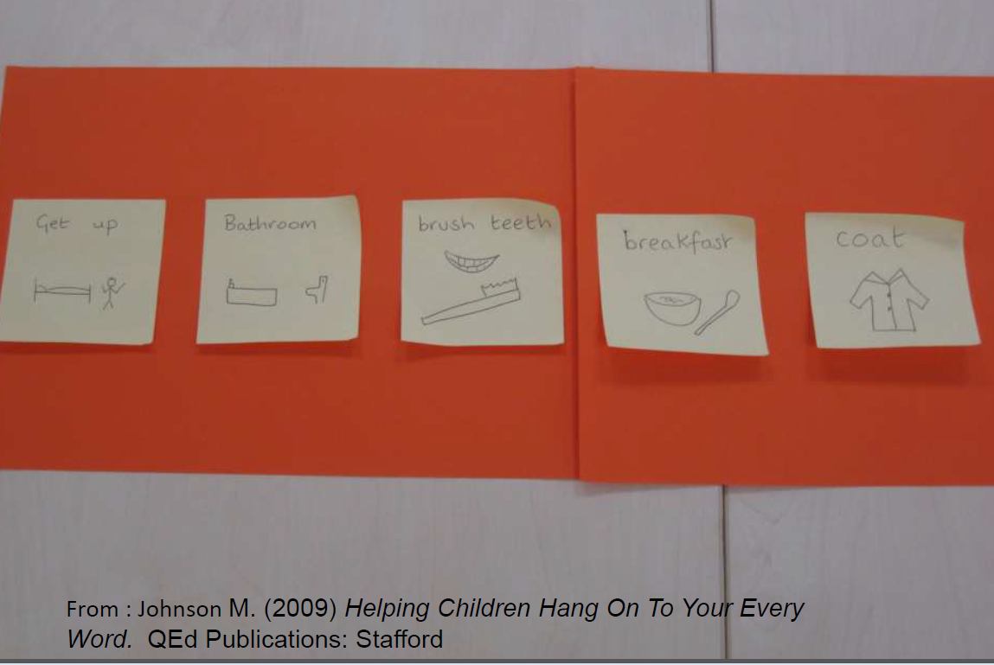
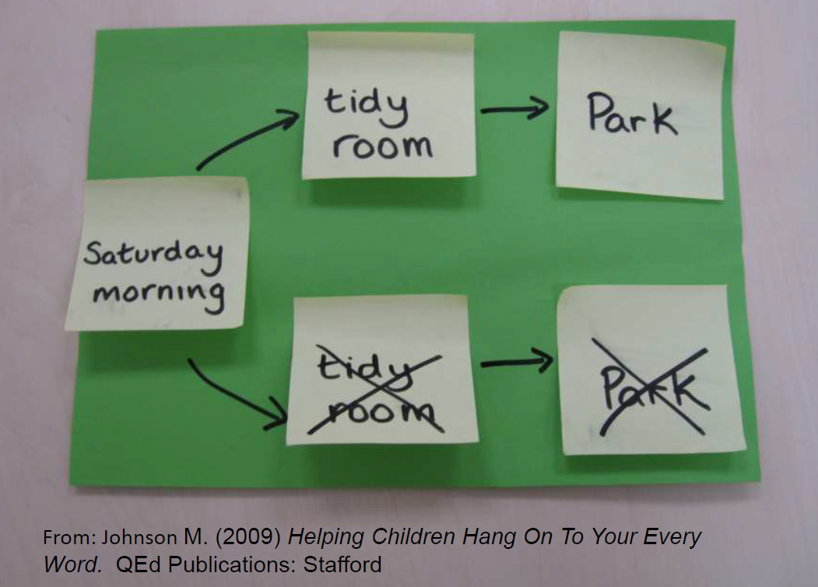
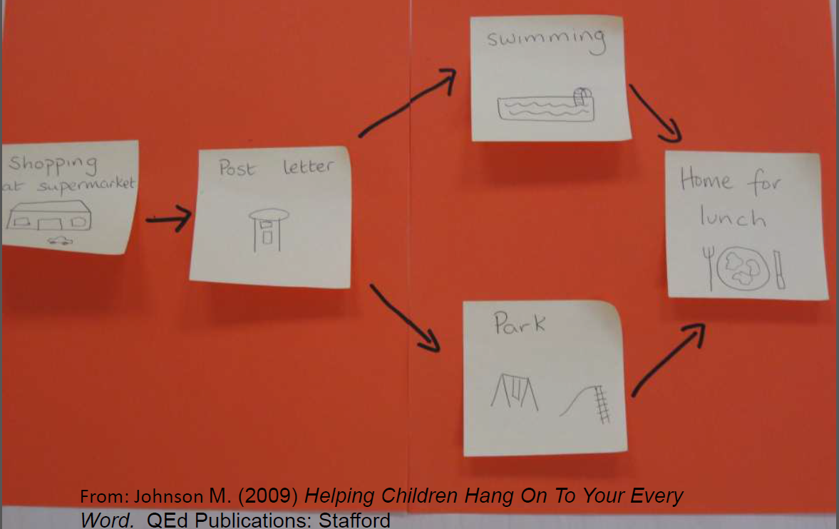
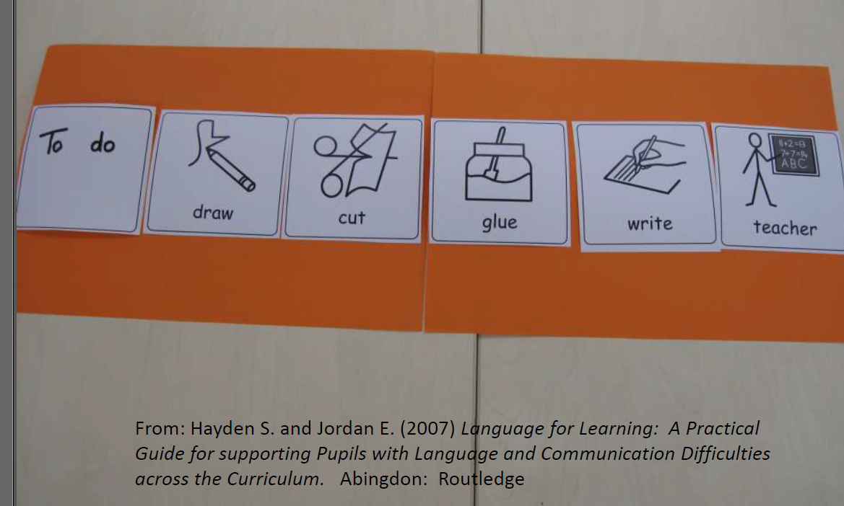
Examples of visual support systems you could use
Notes:
Beverley Mack to present

Slide 13
Examples of visual support systems you could use

Slide 14
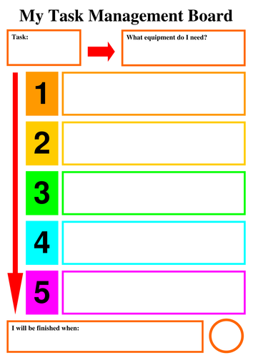
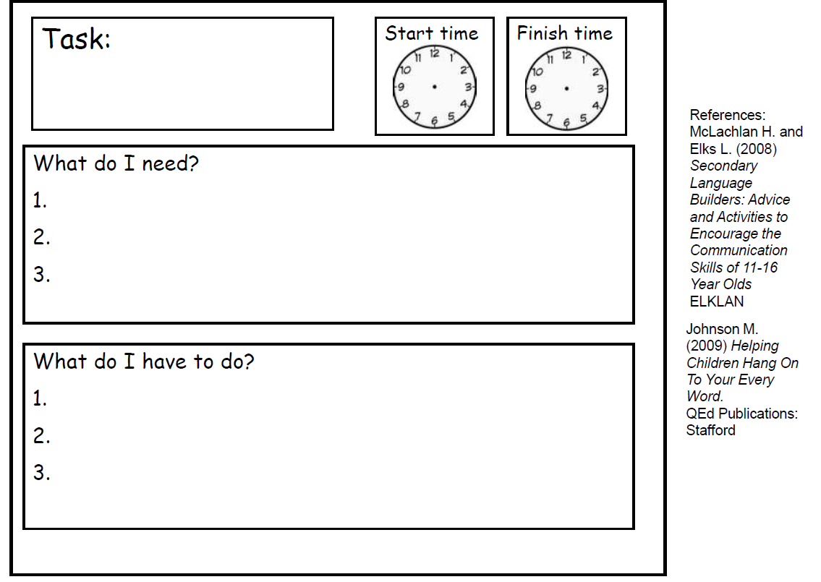
Examples of visual support systems you could use
Notes:
Beverley Mack to present

Slide 15
Games to play at home to help develop attention
Barrier games; eg listen and colour
A listening walk…what sounds can you hear in the park today?
Checklist of things to look out for on your walk/shopping trip/car journey
I went to the shops and I bought…
Spot the deliberate mistake in the familiar story or rhyme
Copying a rhythm
Kim’s game
Simon says
Games such as snap, matching pairs, and bingo where your child has to pay attention in order to win!
See ‘Listen Up’ advice booklet from The Communication Trust

Slide 16
Questions
Any questions about how to support your child’s attention skills?
Notes:
Beverley Mack to present

Slide 17
Thank you

